Slide 1
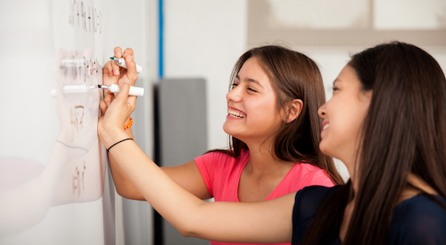
Problem Solving Session
The remainder of today’s class will comprise the problem solving session (PSS).
Your instructor will divide you into teams of 3 or 4 students.
Each team will work together to solve the following problems over the course of 20-30 minutes.
You may work on paper, a white board, or digitally as determined by your instructor.
You will submit your solution by pushing it to GitHub before the end of class.
Your instructor will go over the solution before the end of class.
Class participation is a significant part of your grade (20%). This includes in class activities and the problem solving session.
Your graders will grade your participation by verifying that you pushed your solutions before the end of the class period each day.

Slide 2

Problem Solving Team Members
Amaal
Noora
Kartik
Abbas
Record the name of each of your problem solving team members here.
Do not forget to add every team member’s name! Your instructor (or course assistant) may or may not use this to determine whether or not you participated in the problem solving session.

Slide 3
Problem Solving 1
Int | x = 10
char | x = "Wednesday"
int | x = 23571113171923293137
float | x = 10.3
char | x = "a"
char | x = "123"
char | x = ""
Opp-Division | x = 10 / 3
Opp-Floor | x = 10 // 3
Opp-Addition | x = 3 + 4
Opp-Float | x = 3.0 + 4
Char | x = "True"
Opp | x = 3 + 4.5
Char | x = "3.0" + "4.5"
Examine the code snippets to the right. For each, indicate the type of the variable in the space to the left.

Slide 4
Problem Solving 2
3 * 4 + 6 - 2 | 16
10 / 4 * 3 + 4 | 11.5
10 // 4 * 3 + 4 | 10
12 // 2 / 3 | 2
4 * 3 + 2.0 * 6 | 19
4 + 3 * 2 + 6 | 16
4 / 2 * 6 / 3 | 4
4 + 2 * 3 ** 3 | 58
4 * 2 ** 3 | 32
4 ** 2 * 3 | 48
For each expression to the left, indicate the final result and type in the space to the right.
If the expression is invalid, just write “ERROR”.
Remember: the result of normal division (/) is always a float even if the operands are integers. The result of floor division (//) depends on the types of the operands.

Slide 5
Problem Solving 3
# By Amaal
def info(name,value):
print (f"{name}={value}")
def questions():
global ans_1, ans_2, ans_3
ans_1 = input("What's your favorite TV show? “)
ans_2 = input("What's your favorite animal? “)
ans_3 = input("Do you like fruits? ")
def main():
global ans_1, ans_2, ans_3
questions()
info("Favorite TV show", ans_1)
info("Favorite animal", ans_2)
info("Likes fruits", ans_3)main()
Write a function that declares two parameters: one for some name, and a another for some value. The function should print the name and value in the format: name = value.
Write a second function that prompts the user to enter the answer to three questions. Call your first function from the second to print the user’s answers. Below is an example, but you should come up with your own questions.
What's your favorite number: 6
What color are your eyes: blue
Do you like pizza (yes or no): yes
favorite number = 6
eye color = blue
likes pizza = yes

Slide 6
Problem Solving 4
def main(): Month = input(“Enter your month ”)
Day = input(“Day of the Month ”)
Year = input(“Enter the Year ”)
print (‘Month’, ‘Day’, ‘Year’)
main()
Write a function that prompts the user for the month number (e.g. August = 8) and day of the month and then prints the approximate day of the year (assuming an average of 30.4 days per month).
Imagine that you implemented your answer to this and the previous two questions in the same program, write a main function that calls all three.
Enter the month: 8
Enter the day of month: 24
The approximate day of the year is: 236.79999999999998

